Slide 1
Introduction to Machine Learning

Slide 2
Classification
A machine learning task that deals with identifying the class to which an instance belongs
A classifier performs classification
Classification is an example of pattern recognition
Classifier
Test instance
Attributes (a1, a2,… an)
Category of document? {Politics, Movies, Biology}
Issue Loan? {Yes, No}
( Age, Marital status,
Health status, Salary )

Slide 3
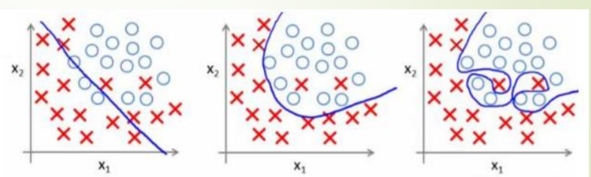
Linear Classification
A classification algorithm (Classifier) that makes its classification based on a linear predictor function combining a set of weights with the feature vector

Slide 4
Classification learning
Training
phase
Training
phase
Learning the classifier from the available data ‘Training set’ (Labeled)
Learning the classifier from the available data ‘Training set’ (Labeled)

Slide 5
Different approaches
Explicitly creating the discriminant function (Discriminant function)
Perceptron
Support vector machine
Probabilistic approach
Model the posterior distribution
Algorithms
Logistic regression

Slide 6
Regression
Regression analysis is a predictive modelling technique
It estimates the relationship between a dependent (target) and an independent (predictor) variables via a sloped straight line
The sloped straight line representing the linear relationship that fits the given data best is called as a regression line.
It is also called as best fit line.

Slide 7
Linear Regression
In Machine Learning,
Linear Regression is a supervised machine learning algorithm
It tries to find out the best linear relationship that describes the data you have
It assumes that there exists a linear relationship between a dependent variable and independent variable(s)
The value of the dependent variable of a linear regression model is a continuous value i.e. real numbers

Slide 8
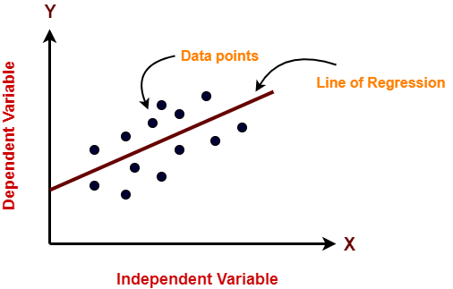
Representing Linear Regression Model

Slide 9
Types of Linear Regression
Simple Linear Regression
Multiple Linear Regression
Polynomial Linear Regression

Slide 10
Simple Linear Regression
In simple linear regression, the dependent variable depends only on a single independent variable
For simple linear regression, the form of the model is-
Y = β0 + β1X
Here,
Y is a dependent variable
X is an independent variable
β0 and β1 are the regression coefficients
β0 is the intercept or the bias that fixes the offset to a line
β1 is the slope or weight that specifies the factor by which X has an impact on Y

Slide 11
Multiple Linear Regression
In multiple linear regression, the dependent variable depends on more than one independent variables.
For multiple linear regression, the form of the model is-
Y = β0 + β1X1 + β2X2 + β3X3 + …… + βnXn
Here,
Y is a dependent variable
X1, X2, …., Xn are independent variables
β0, β1,…, βn are the regression coefficients
βj (1<=j<=n) is the slope or weight that specifies the factor by which Xj has an impact on Y

Slide 12
Polynomial Linear Regression
Polynomial Regression is a regression algorithm that models the relationship between a dependent(y) and independent variable(x) as nth degree polynomial. The Polynomial Regression equation is given below:
y= b0+b1x1+ b2x12+ b2x13+...... bnx1n
It is also called the special case of Multiple Linear Regression in ML. Because we add some polynomial terms to the Multiple Linear regression equation to convert it into Polynomial Regression.
It is a linear model with some modification in order to increase the accuracy.
The dataset used in Polynomial regression for training is of non-linear nature.
It makes use of a linear regression model to fit the complicated and non-linear functions and datasets.

Slide 13
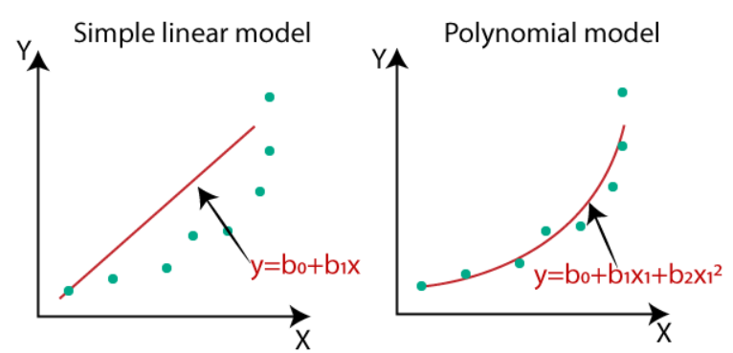
Polynomial Linear Regression

Slide 14
Univariate Linear Regression
Univariate linear regression focuses on determining relationship between one independent (explanatory variable) variable and one dependent variable. Regression comes handy mainly in situation where the relationship between two features is not obvious to the naked eye. For example, it could be used to study how the terrorist attacks frequency affects the economic growth of countries around the world or the role of unemployment in a country in the bankruptcy of the government
Univariate data is the type of data in which the result depends only on one variable. For instance, dataset of points on a line can be considered as a univariate data where abscissa can be considered as input feature and ordinate can be considered as output/result
For example: For line Y = 2X + 3; Input feature will be X and Y will be the result.

Slide 15
Univariate Linear Regression
X Y
1 5
2 7
3 9
4 11
5 13
For univariate linear regression, there is only one input feature vector. The line of regression will be in the form of:
Y = b0 + b1 * X
Where,
b0 and b1 are the coefficients of regression.
Hence, it is being tried to predict regression coefficients b0 and b1 by
training a model.

Slide 16
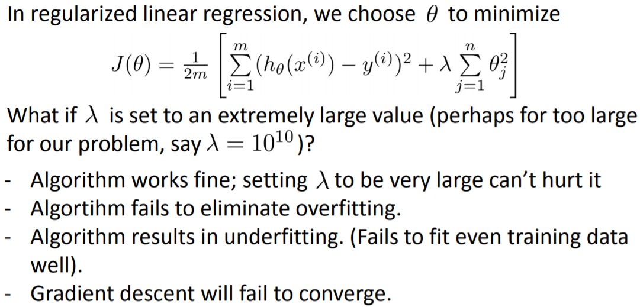
Regularized Linear Regression

Slide 17
Logistic Linear Regression
Logistic Regression is a Machine Learning algorithm which is used for the classification problems, it is a predictive analysis algorithm and based on the concept of probability
Logistic regression is a classification algorithm used to assign observations to a discrete set of classes. Some of the examples of classification problems are Email spam or not spam, Online transactions Fraud or not Fraud, Tumor Malignant or Benign. Logistic regression transforms its output using the logistic sigmoid function to return a probability value.

Slide 18
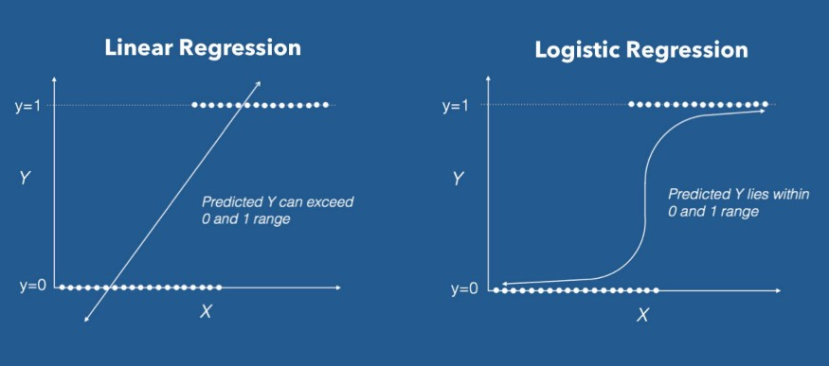
Logistic Linear Regression
Logistic Regression is a Machine Learning algorithm which is used for the classification problems, it is a predictive analysis algorithm and based on the concept of probability
Logistic regression is a classification algorithm used to assign observations to a discrete set of classes. Some of the examples of classification problems are Email spam or not spam, Online transactions Fraud or not Fraud, Tumor Malignant or Benign. Logistic regression transforms its output using the logistic sigmoid function to return a probability value.

Slide 19
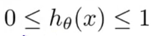
Logistic Linear Regression
We can call a Logistic Regression a Linear Regression model but the Logistic Regression uses a more complex cost function, this cost function can be defined as the ‘Sigmoid function’ or also known as the ‘logistic function’ instead of a linear function
The hypothesis of logistic regression tends it to limit the cost function between 0 and 1. Therefore linear functions fail to represent it as it can have a value greater than 1 or less than 0 which is not possible as per the hypothesis of logistic regression
Logistic regression hypothesis expectation

Slide 20
Types of Logistic Regression
Binary or Binomial
In such a kind of classification, a dependent variable will have only two possible types either 1 and 0. For example, these variables may represent success or failure, yes or no, win or loss etc
Multinomial
In such a kind of classification, dependent variable can have 3 or more possible unordered types or the types having no quantitative significance. For example, these variables may represent “Type A” or “Type B” or “Type C”
Ordinal
In such a kind of classification, dependent variable can have 3 or more possible ordered types or the types having a quantitative significance. For example, these variables may represent “poor” or “good”, “very good”, “Excellent” and each category can have the scores like 0,1,2,3

Slide 21
Logistic Regression Assumptions
Before diving into the implementation of logistic regression, we must be aware of the following assumptions about the same −
In case of binary logistic regression, the target variables must be binary always and the desired outcome is represented by the factor level 1
There should not be any multi-collinearity in the model, which means the independent variables must be independent of each other
We must include meaningful variables in our model
We should choose a large sample size for logistic regression

Slide 22
Logistic Regression Models
Binary Logistic Regression Model − The simplest form of logistic regression is binary or binomial logistic regression in which the target or dependent variable can have only 2 possible types either 1 or 0
Multinomial Logistic Regression Model − Another useful form of logistic regression is multinomial logistic regression in which the target or dependent variable can have 3 or more possible unordered types i.e. the types having no quantitative significance

Slide 23
Perceptron
Also known as Layered Feed-Forward Networks
The only efficient learning element at that time was for single-layered networks
Today, used as a synonym for a single-layer, feed-forward network

Slide 24
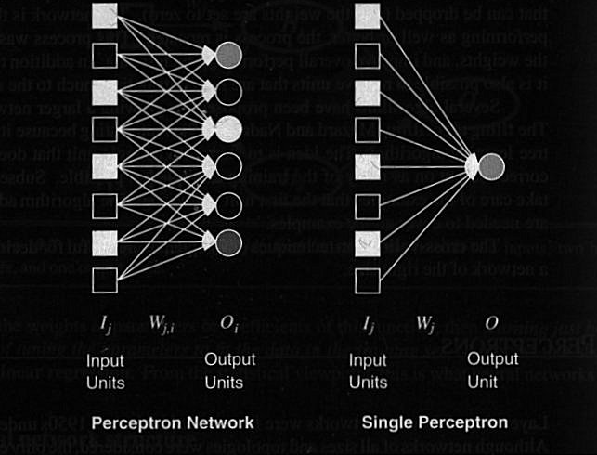
Perceptron

Slide 25
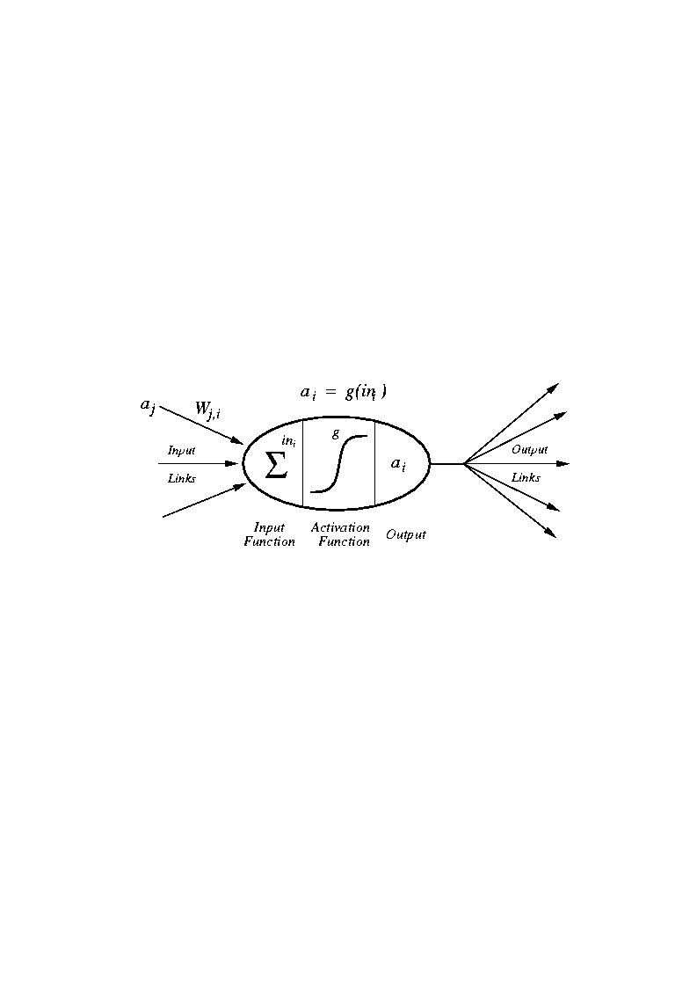
Perceptron

Slide 26
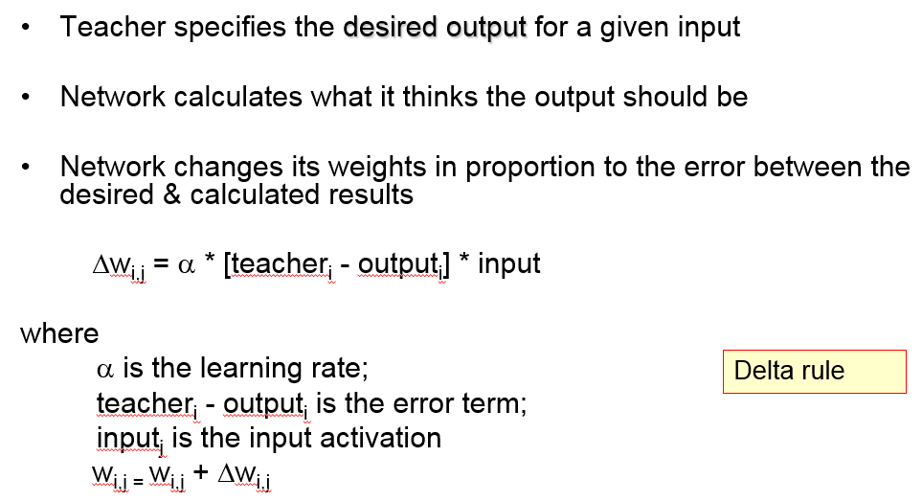
Perceptron Learning Rule

Slide 27
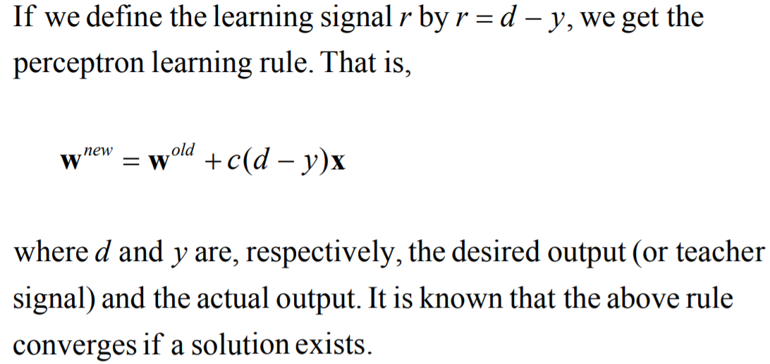
Perceptron Learning Rule

Slide 28
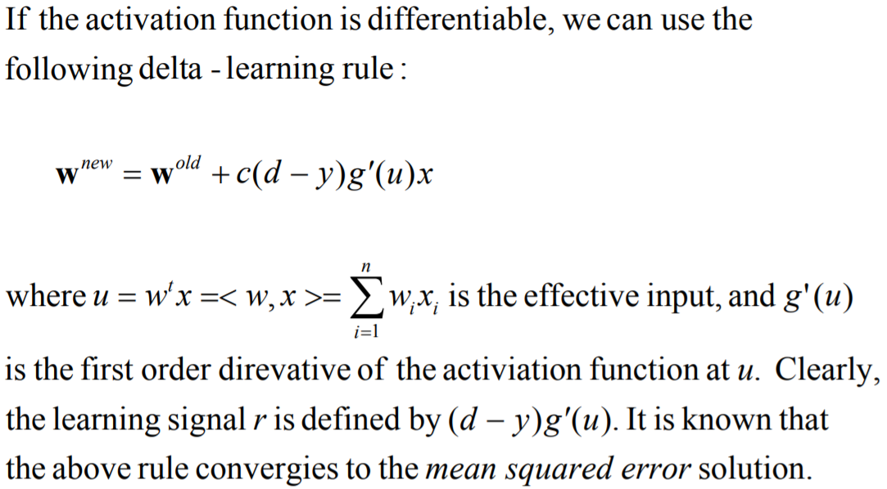
Delta Learning Rule

Slide 29
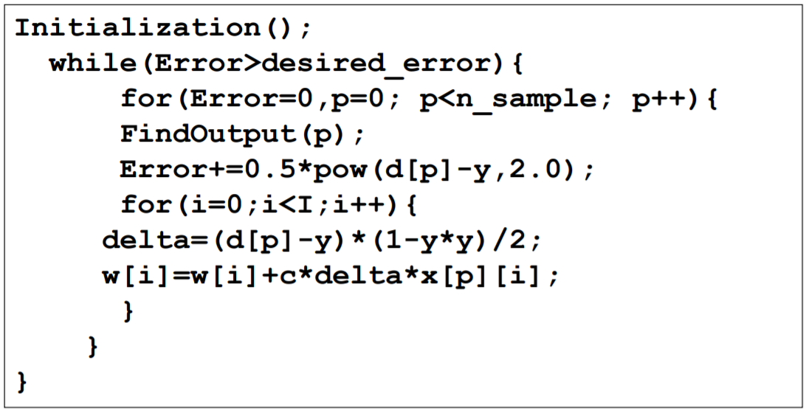
Program for Delta Learning Rule

Slide 30
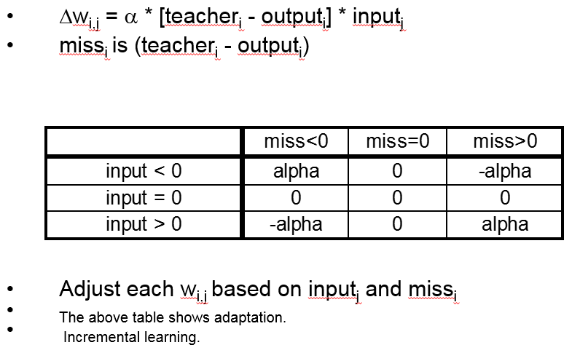
Adjusting Perceptron Weights

Slide 31
Perceptron Convergence Theorem
If a set of <input, output> pairs are learnable (representable), the delta rule will find the necessary weights
-in a finite number of steps
-independent of initial weights
However, a single layer perceptron can only learn linearly separable concepts
-it works iff gradient descent works

Slide 32
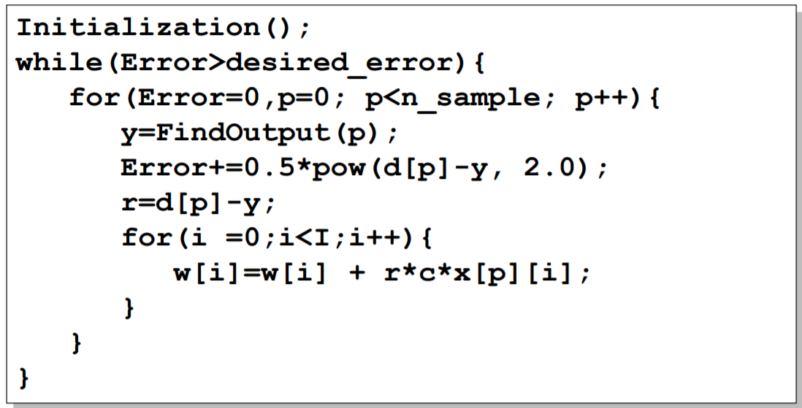
Program for Perceptron Learning

Slide 33
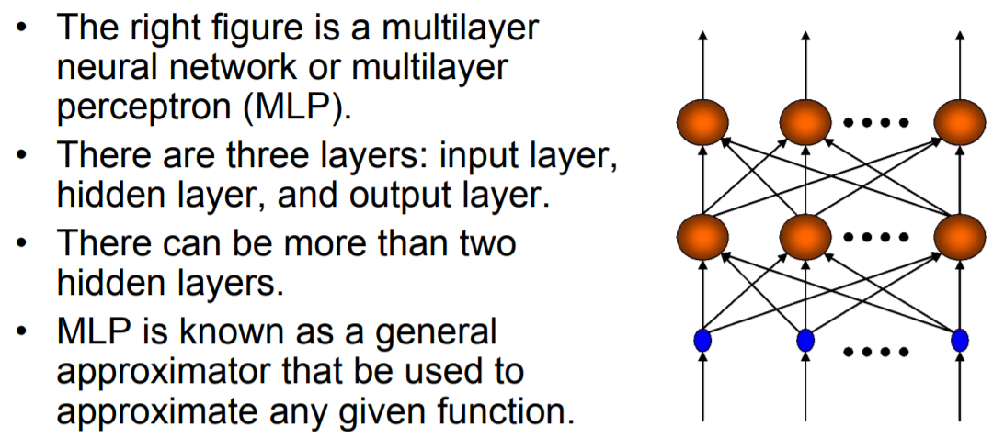
Multilayer Perceptron

Slide 34
Multilayer Neural Networks
Identifying the appropriate nonlinear functions to be used can be difficult and incredibly expensive
We need a way to learn the non-linearity at the same time as the linear discriminant
Multilayer Neural Networks, in principle, do exactly this in order to provide the optimal solution to arbitrary classification problems
Multilayer Neural Networks implement linear discriminants in a space where the inputs have been mapped non-linearly
The form of the non-linearity can be learned from simple algorithms on training data
Note that neural networks require continuous functions to allow for gradient descent

Slide 35
Multilayer Neural Networks
Training multilayer neural networks can involve a number of different algorithms, but the most popular is the back propagation algorithm or generalized delta rule
Back propagation is a natural extension of the LMS algorithm
The back propagation method is simple for models of arbitrary complexity
This makes the method very flexible
One of the largest difficulties with developing neural networks is regularization, or adjusting the complexity of the network
Too many parameters = poor generalization
Too few parameters = poor learning

Slide 36
Learning in Multilayer Neural Networks
Learning consists of searching through the space of all possible matrices of weight values for a combination of weights that satisfies a database of positive and negative examples (multi-class as well as regression problems are possible)
Note that a Neural Network model with a set of adjustable weights defines a restricted hypothesis space corresponding to a family of functions. The size of this hypothesis space can be increased or decreased by increasing or decreasing the number of hidden units present in the network

Slide 37
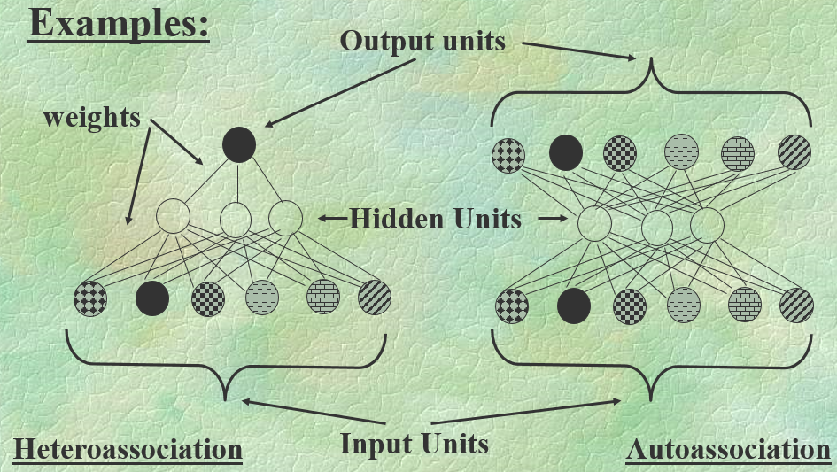
Multilayer Neural Network Representation

Slide 38
How a Multi-Layer Neural Network Works?
The inputs to the network correspond to the attributes measured for each training tuple
Inputs are fed simultaneously into the units making up the input layer
They are then weighted and fed simultaneously to a hidden layer
The number of hidden layers is arbitrary, although usually only one
The weighted outputs of the last hidden layer are input to units making up the output layer, which emits the network's prediction
The network is feed-forward in that none of the weights cycles back to an input unit or to an output unit of a previous layer
From a statistical point of view, networks perform nonlinear regression: Given enough hidden units and enough training samples, they can closely approximate any function

Slide 39
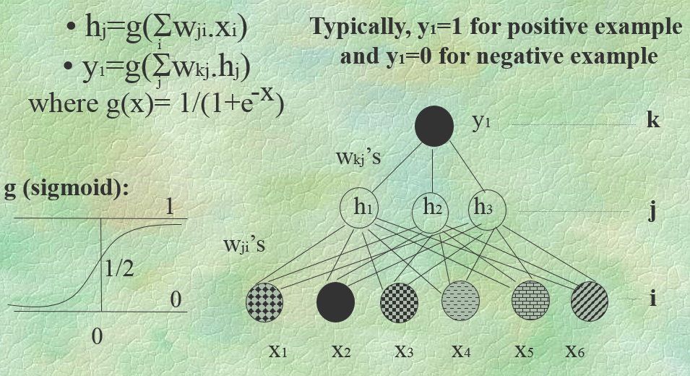
How is a Function Computed by a Multilayer Neural Network?

Slide 40
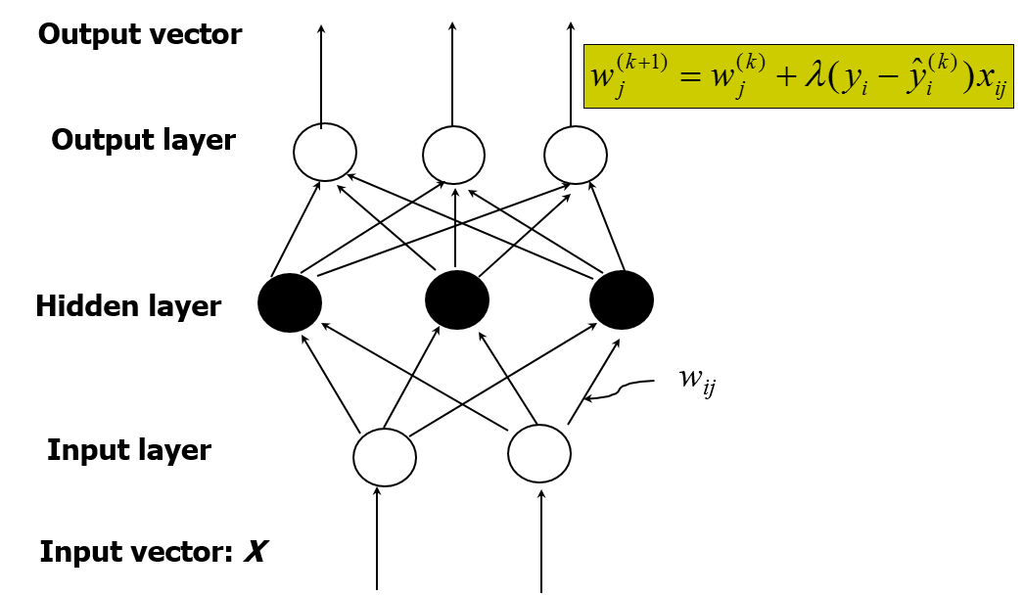
A Multi-Layer Feed-Forward Neural Network

Slide 41
Support Vector Machines
Support Vector Machine (SVM) is related to statistical learning theory
SVM was first introduced in 1992
SVM becomes popular because of its success in handwritten digit recognition
SVM is now regarded as an important example of “kernel methods”, one of the key area in machine learning

Slide 42
Support Vector Machines
Three main ideas:
Define what an optimal hyperplane is (taking into account that it needs to be computed efficiently): maximize margin
Generalize to non-linearly separable problems: have a penalty term for misclassifications
Map data to high dimensional space where it is easier to classify with linear decision surfaces: reformulate problem so that data are mapped implicitly to this space

Slide 43
Motivation for Support Vector Machines
The problem to be solved is one of the supervised binary classification. That is, we wish to categorize new unseen objects into two separate groups based on their properties and a set of known examples, which are already categorized
A good example of such a system is classifying a set of new documents into positive or negative sentiment groups, based on other documents which have already been classified as positive or negative
Similarly, we could classify new emails into spam or non-spam, based on a large corpus of documents that have already been marked as spam or non-spam by humans. SVMs are highly applicable to such situations

Slide 44
Motivation for Support Vector Machines
A Support Vector Machine models the situation by creating a feature space, which is a finite-dimensional vector space, each dimension of which represents a "feature" of a particular object. In the context of spam or document classification, each "feature" is the prevalence or importance of a particular word
The goal of the SVM is to train a model that assigns new unseen objects into a particular category.
It achieves this by creating a linear partition of the feature space into two categories
Based on the features in the new unseen objects (e.g. documents/emails), it places an object "above" or "below" the separation plane, leading to a categorization (e.g. spam or non-spam). This makes it an example of a non-probabilistic linear classifier. It is non-probabilistic, because the features in the new objects fully determine its location in feature space and there is no stochastic element involved

Slide 45
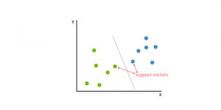
Objectives of Support Vector Machines
Support vector machines (SVM) are supervised learning models with associated learning algorithms that analyze data used for classification and regression analysis
It is a machine learning approach
They analyze the large amount of data to identify patterns from them.
SVMs are based on the idea of finding a hyperplane that best divides a dataset into two classes, as shown in the image below

Slide 46
Support Vectors
Support Vectors are simply the co-ordinates of individual observation. Support Vector Machine is a frontier which best segregates the two classes (hyper-plane/ line)
Support vectors are the data points that lie closest to the decision surface (or hyperplane)
They are the data points most difficult to classify
They have direct bearing on the optimum location of the decision surface
We can show that the optimal hyperplane stems from the function class with the lowest “capacity” (VC dimension)
Support vectors are the data points nearest to the hyperplane, the points of a data set that, if removed, would alter the position of the dividing hyperplane. Because of this, they can be considered the critical elements of a data set

Slide 47
What is a hyperplane?
As a simple example, for a classification task with only two features, you can think of a hyperplane as a line that linearly separates and classifies a set of data
Intuitively, the further from the hyperplane our data points lie, the more confident we are that they have been correctly classified. We therefore want our data points to be as far away from the hyperplane as possible, while still being on the correct side of it
So when new testing data are added, whatever side of the hyperplane it lands will decide the class that we assign to it

Slide 48
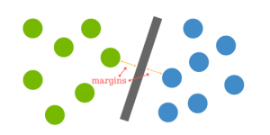
How do we find the right hyperplane?
How do we best segregate the two classes within the data?
The distance between the hyperplane and the nearest data point from either set is known as the margin. The goal is to choose a hyperplane with the greatest possible margin between the hyperplane and any point within the training set, giving a greater chance of new data being classified correctly. There will never be any data point inside the margin

Slide 49

What happens when there is no clear hyperplane?
Data are rarely ever as clean as our simple example above. A dataset will often look more like the jumbled balls below which represent a linearly non separable dataset
In order to classify a dataset like the one above it’s necessary to move away from a 2d view of the data to a 3d view. Explaining this is easiest with another simplified example. Imagine that our two sets of colored balls above are sitting on a sheet and this sheet is lifted suddenly, launching the balls into the air. While the balls are up in the air, you use the sheet to separate them. This ‘lifting’ of the balls represents the mapping of data into a higher dimension. This is known as kernelling

Slide 50
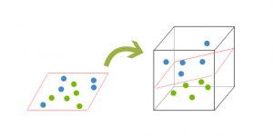
What happens when there is no clear hyperplane?
Because we are now in three dimensions, our hyperplane can no longer be a line. It must now be a plane as shown in the example above. The idea is that the data will continue to be mapped into higher and higher dimensions until a hyperplane can be formed to segregate it.

Slide 51
How does it work? How can we identify the right hyper-plane?
You need to remember a thumb rule to identify the right hyper-plane:
“Select the hyper-plane which segregates the two classes better”.

Slide 52
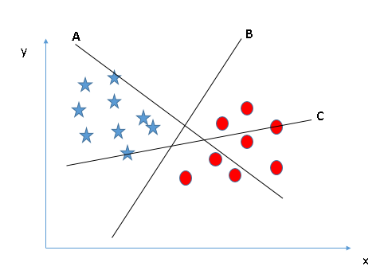
Identify the right hyperplane (Scenario-1)
Here, we have three hyperplanes (A, B and C). Now, identify the right hyperplane to classify star and circle.
Hyperplane “B” has excellently performed this job.

Slide 53
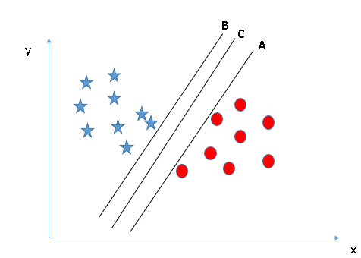
Identify the right hyperplane (Scenario-2)
Here, we have three hyperplanes (A, B and C) and all are segregating the classes well. Now, how can we identify the right hyperplane?
Here, maximizing the distances between nearest data point (either class) and hyperplane will help us to decide the right hyperplane

Slide 54
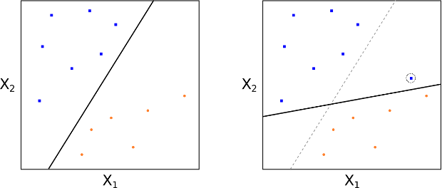
Support Vector Classifiers
Essentially, we have to relax the requirement that a separating hyperplane will perfectly separate every training observation on the correct side of the line (i.e. guarantee that it is associated with its true class label), using what is called a soft margin. This motivates the concept of a support vector classifier(SVC)
MMCs can be extremely sensitive to the addition of new training observations
If we add one point to the +1 class, we see that the location of the MMH changes substantially. Hence in this situation the MMH has clearly been over-fit.
MMH perfectly separating the two classes

Slide 55
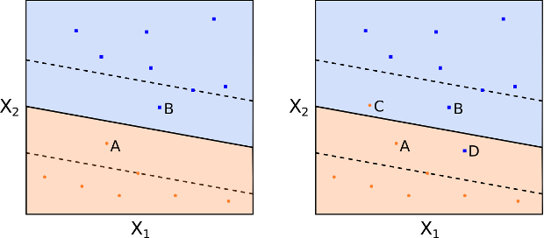
Support Vector Classifiers
We could consider a classifier based on a separating hyperplane that doesn't perfectly separate the two classes, but does have a greater robustness to the addition of new individual observations and has a better classification on most of the training observations. This comes at the expense of some misclassification of a few training observations
This is how a support vector classifier or soft margin classifier works. A SVC allows some observations to be on the incorrect side of the margin (or hyperplane), hence it provides a "soft" separation. The following figures demonstrate observations being on the wrong side of the margin and the wrong side of the hyperplane respectively:

Slide 56
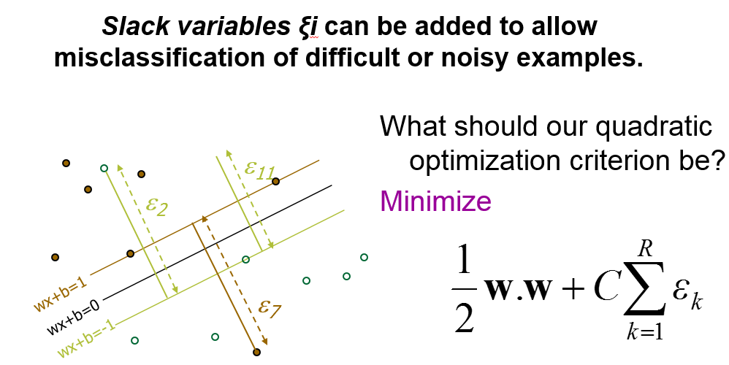
Soft Margin Classification
Overfitting can be controlled by soft margin approach

Slide 57
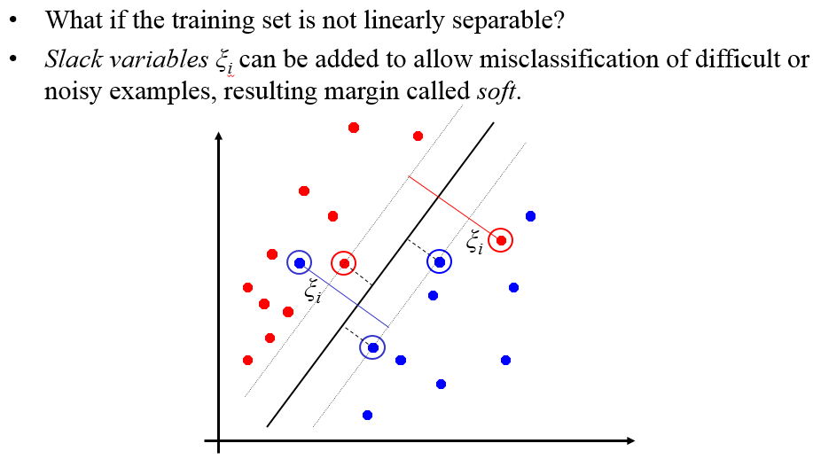
Soft Margin Classification

Slide 58
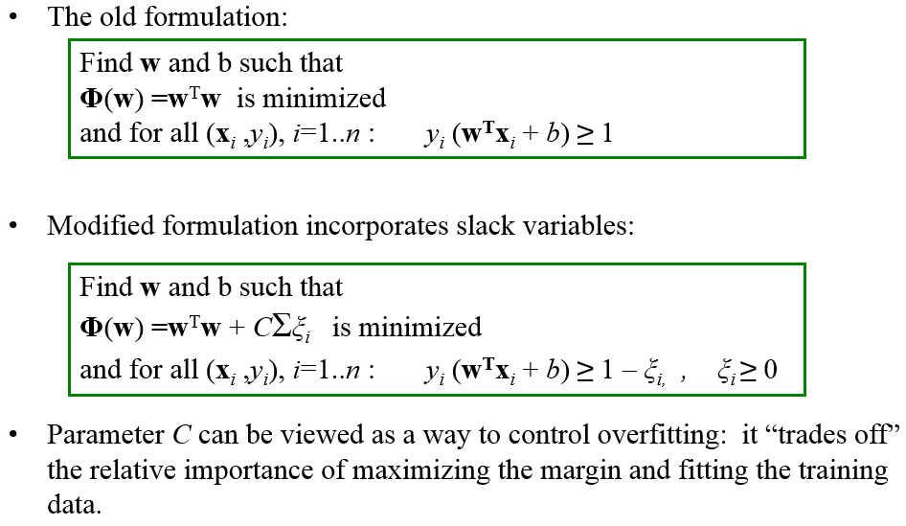
Soft Margin Classification Mathematically

Slide 59
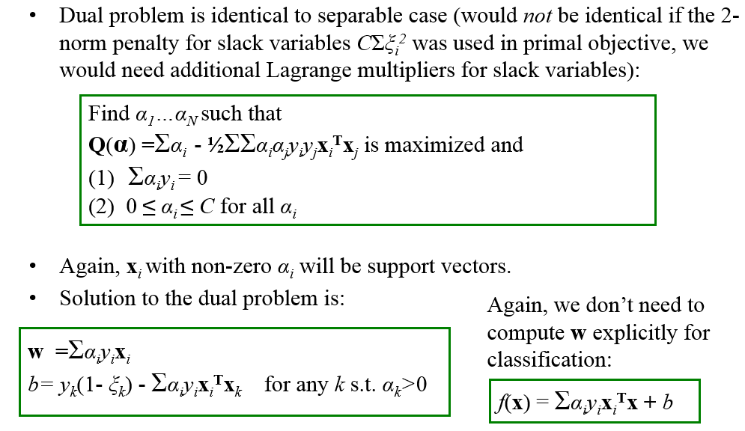
Soft Margin Classification – Solution

Slide 60
Generalization and Over Fitting
Generalization is the model’s ability to give sensible outputs to sets of input that it has never seen before
Arguably, Machine Learning models have one sole purpose; to generalize well
A model that generalizes well is a model that is neither underfit nor overfit
When we run our training algorithm on the data set, we allow the overall cost (i.e. distance from each point to the line) to become smaller with more iterations. Leaving this training algorithm run for long leads to minimal overall cost. However, this means that the line will be fit into all the points (including noise), catching secondary patterns that may not be needed for the generalizability of the model
If we leave the learning algorithm running for long, it cold end up fitting the line in the following manner:

Slide 61
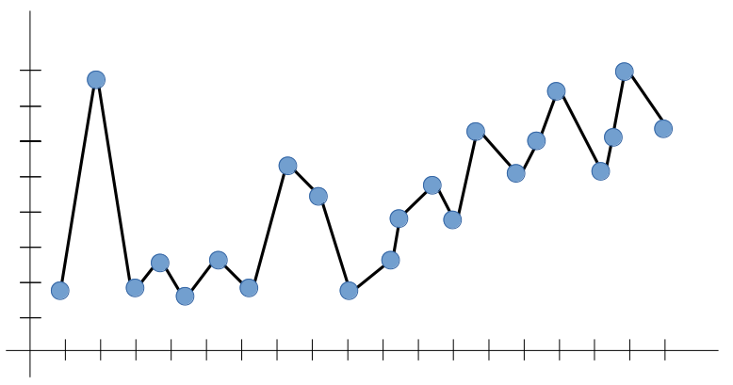
Generalization and Over Fitting
This looks good, right? Yes, but is it reliable? Well, not really

Slide 62
Generalization and Over Fitting
In the figure above, the algorithm captured all trends — but not the dominant one. If we want to test the model on inputs that are beyond the line limits we have (i.e. generalize), what would that line look like? There is really no way to tell. Therefore, the outputs aren’t reliable
If the model does not capture the dominant trend that we can all see (positively increasing, in our case), it can’t predict a likely output for an input that it has never seen before — defying the purpose of Machine Learning to begin with

Slide 63
Regularization
Too many parameters = overfitting
Not enough parameters = underfitting
More data = less chance to overfit
How do we know what is required?

Slide 64
Regularization
Attempt to guide solution to not overfit
But still give freedom with many parameters

Slide 65
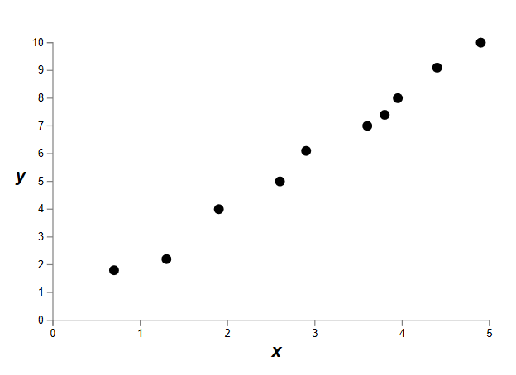
Data fitting problem

Slide 66
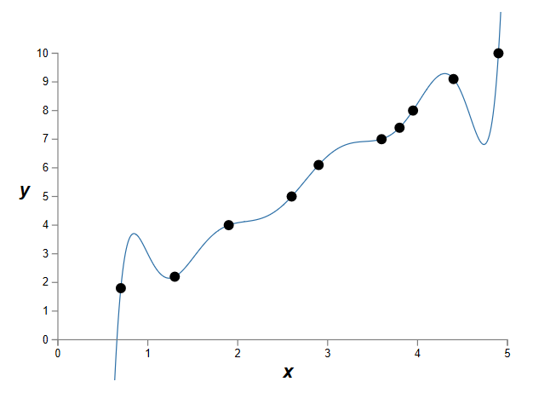
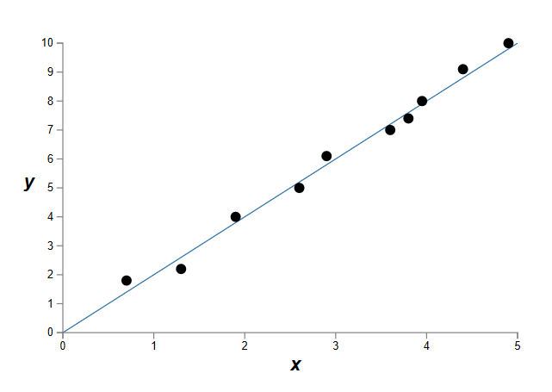
Which is better a priori?
9th order polynomial
1st order polynomial

Slide 67
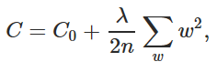
Regularization
Attempt to guide solution to not overfit
But still give freedom with many parameters
Idea: Penalize the use of parameters to prefer small weights.
Idea: add a cost to having high weights
λ = regularization parameter

Slide 68
Forms of Regularization
Adding more data is a kind of regularization
Pooling is a kind of regularization
Data augmentation is a kind of regularization

Slide 69
Validation
Cross-validation generates an approximate estimate of how well the learned model will do on “unseen” data
By averaging over different partitions it is more robust than just a single train/validate partition of the data
“k-fold” cross-validation is a generalization
partition data into disjoint validation subsets of size n/k
train, validate, and average over the v partitions
e.g., k=10 is commonly used
k-fold cross-validation is approximately k times computationally more expensive than just fitting a model to all of the data

Slide 70
Cross-Validation
Split original set of examples, train
Examples D
-
+
-
-
+
-
-
-
-
+
+
+
+
-
-
+
Train
+
+
+
-
-
-
+
+
Hypothesis space H

Slide 71
Cross-Validation
Evaluate hypothesis on testing set
Testing set
-
-
-
-
+
+
+
+
+
+
-
-
+
Hypothesis space H

Slide 72
Cross-Validation
Evaluate hypothesis on testing set
Testing set
-
+
+
-
+
+
+
Test
-
+
+
-
-
-
Hypothesis space H

Slide 73
Cross-Validation
Compare true concept against prediction
9/13 correct
Testing set
-
-
-
+
-
+
-
-
+
+
+
+
+
+
+
-
+
+
+
+
-
-
-
-
+
-
Hypothesis space H

Slide 74
Common Splitting Strategies
k-fold cross-validation
Dataset
Train
Test

Slide 75
Common Splitting Strategies
k-fold cross-validation
Leave-one-out (n-fold cross validation)
Dataset
Train
Test

Slide 76
References
Duda, R., Hart, P., Stork, D. Pattern Classification, 2nd ed. John Wiley & Sons,2001.
Y. LeCun, L. Bottou, G.B. Orr, and K.-R. Muller. Efficient Backprop. NeuralNetworks: Tricks of the Trade, Springer Lecture Notes in Computer Sciences,No. 1524, pp. 5-50, 1998.
P. Simard, D. Steinkraus, and J. Platt. Best Practice for Convolutional Neural Networks Applied to Visual Document Analysis. International Conference on Document Analysis and Recognition, ICDAR 2003, IEEE Computer Society, Vol. 2, pp. 958-962, 2003.
L. Tsu-Chang, Structure Level Adaptation for Artificial Neural Networks, KluwerAcademic Publishers, Boston, 1991.
Ramirez, J.M.; Gomez-Gil, P.; Baez-Lopez, D., "On structural adaptability of neural networks in character recognition," Signal Processing, 1996., 3rd International Conference on , vol.2, no., pp.1481-1483 vol.2, 14-18 Oct 1996.

Slide 77

Thank you

